Slide 1
B2B Sales Effectiveness & Efficiency - building a scalable sales organization
Phil Solk
Managing Partner
Opero Partners
phil@operopartners.com
650.291.9461
Alliance For Executives
Biltmore Hotel - Santa Clara
November 6, 2015
Notes:
Focus on B2B or Partnerships for B2C
Bring slides on flash drive – ppx
Post slides after meeting
Talk for 20-30 minutes, then questions 7:45-9:55
A day or two before hand send doc

Slide 2
Characteristics of a well run and scalable function
Accountability
Clear ownership of each role
Success measurements
Process
Repeatable
Scalable
Consistent results
Content
Domain knowledge
Do you have a department that is strong and scalable in all three areas?
Is the department you selected sales?
Notes:
-need definitions of each & examples (cash flow, support (support is good for describing the three factores)
How many of you in the room have a well run scalable function?
If you are in B2B, please keep your hands up
How many of you would describe your sales group this way?

Slide 3

Sales scalability
Accountability
Process
Content
Notes:
Past couple months 2 companies have received acquisition offers where sales was stronger in my clients
Doesn’t need to be fancy or esoteric
Pragmatic
Straight forward
Requires a lot of work

Slide 4
Accountability
The problem
Typical sales personality challenging to manage
Difficult job - can lead to burnout or coasting
Sales hostage situations common
Notes:
Add- “stay at top discussion (vs storytelling) approach
Constant weekly inspection
Constant tug of war
People making quota (revenue versus profit measurement (minimum discount, pay on margin, profit bonus)
Break even
Management involvement in key opportunities
Odds & Dates
Pipeline resets
No story telling
Peer pressure
Commitment
Best single thing you can do
Quotas (Opportunity will not shrink, but territories will and quotas will increase)
Without accountability nothing new will ever happen
Consequences
TWO Approaches

Slide 5
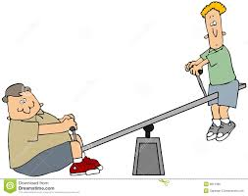
Sales hostage situations
Sales Management
Too few sales people making quota
Non performers retained
Sales leadership delegated to sales management
Territory monopolies
Lead flow monopolies
Goal misalignment built into comp plan
Pipeline becomes a formality – frequent resets
Executive leadership in building effective sales model
Recruiting model
New sales people ramp up timely and predictable
Optimize territories to business needs
Distributing leads by close rates/performance
Goal alignment through comp plan
Accurate pipeline management (i.e. odds and close dates)
Notes:
Use revenue versus profit sales plan problem

Slide 6

Two Accountability models
Level 2 sales team
Focus on accountability leg of the stool
Requires …
Significant market pull
Prospect driven decision process
Large number of leads
Content
Process
Accountability
Level 3 sales team
Higher close rates
Increased odds & close date accuracy
Content
Process
Accountability

Slide 7
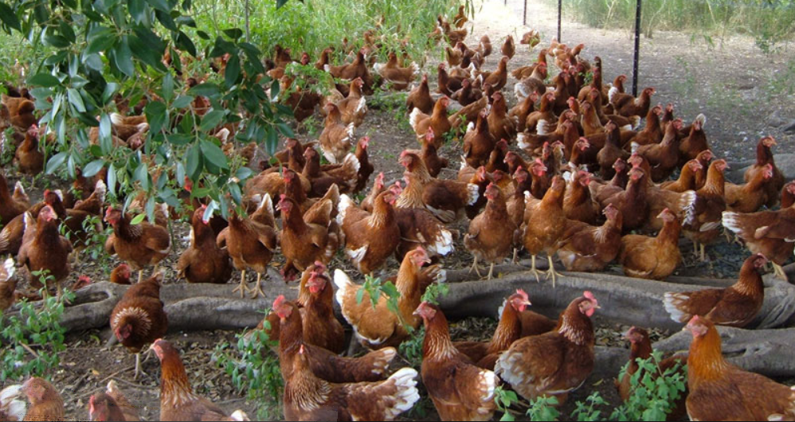
Level 3 Selling
Catalogue of 11 sales statements for “larger sales”
Positive = Positive correlation to higher close rates
Neutral = No correlation to close rates
Negative = Correlation to lower close rates
The Competition . . .
Notes:
L3 requires work

Slide 8
Opening Benefits statements...
Positive
Neutral
Negative

Slide 9
Situation statements ...
Positive
Neutral
Negative

Slide 10
Problem statements ...
Positive
Neutral
Negative

Slide 11
Closing statements ...
Positive
Neutral
Negative

Slide 12
Personal questions ...
Positive
Neutral
Negative

Slide 13
Implication questions ...
Positive
Neutral
Negative

Slide 14
Needs/Payoff questions ...
Positive
Neutral
Negative

Slide 15
Feature statements...
Positive
Neutral
Negative

Slide 16
Prospect objections ...
Positive
Neutral
Negative

Slide 17
Advantage statements ...
Positive
Neutral
Negative

Slide 18
Benefit statements ...
Positive
Neutral
Negative

Slide 19
Which statements help in larger sales?
 | Positive | Neutral | Negative
Opening benefits statements
Situational questions
Problem questions
Closing statements
Personal questions
Implication questions
Needs/Payoff questions
Feature statements
Prospect objections
Advantage statements
Benefit statements
“Spin Selling”, Neil Rackham 1988
Notes:
Objections (>50% a result of Closing questions)

Slide 20
Process
Odds & close dates at the opportunity level
Multiple approaches used
Storytelling
Statistical
Key questions
Odds & close date set by prospect
Customer Driven Odds – Measuring decision process involvement
10% Sponsor agrees to introduce to business sponsor
25% Business value and specific capabilities to be implemented
50% Complete validation plan and target implementation date
75% Verbal approval
Letters to prospects summarizing conversations
Driving by weekly sales meeting
Notes:
Services ultra critical but always important

Slide 21
Content
Content for Level 2 selling
Basic information describing your offering
References
Approaches to handling common objections
Content for level 3 selling = value to the prospects decision process
Dialogues that focus on linking your capabilities to prospect’s business problem
Calculators and rules of thumb for benefit’s your capabilities
Case studies
Industry numbers
This material is also the core content for lead gen activities
Examples:
Dollars not Dimes (Logistics)
Capabilities not Features (Services, SaaS)
Lost without a map (Agriculture)
Pilot Queen & Demo Kings (Agriculture, Software)

